Slide 1
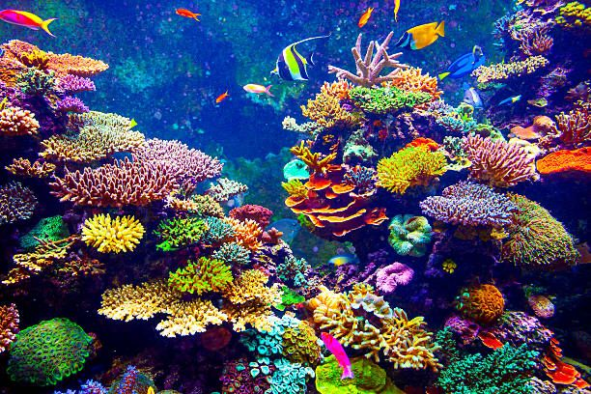
CORAL REEFS-THE TROPICAL RAINFORESTS OF THE SEA
GROUP 8

Slide 2
Outline
Introduction
The formation of reefs
Types of coral reefs
Examples of coral reefs
Coral reefs as tropical rainforests Of the sea
Organisms living on coral reefs
Importance Of coral reefs
Threats faced by coral reefs
Future Of coral reefs

Slide 3
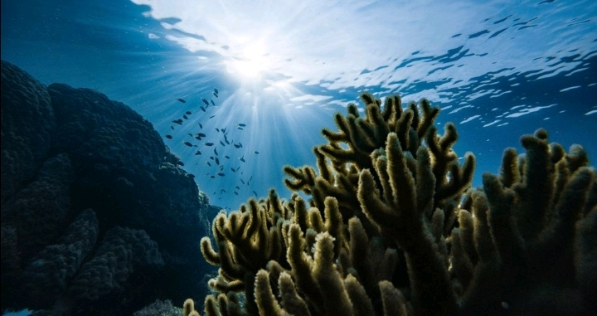
Introduction
Coral reefs are hills of rough, sharp pointed rocks formed by deposition of calcium carbonate by calcareous corals.
They are formed on the sea floors in tropical regions.
fig.1 Coral polyps

Slide 4
Formation of coral reefs
Coral reefs are formed through the following processes:
Establishment of symbiotic relationship
Production and deposition of calcium carbonate
Reef formation

Slide 5
Types of coral reefs
According to the Coral Reef Alliance, there are four types namely:
Fringing Reefs
Barrier Reefs
Atolls
Patch Reefs

Slide 6
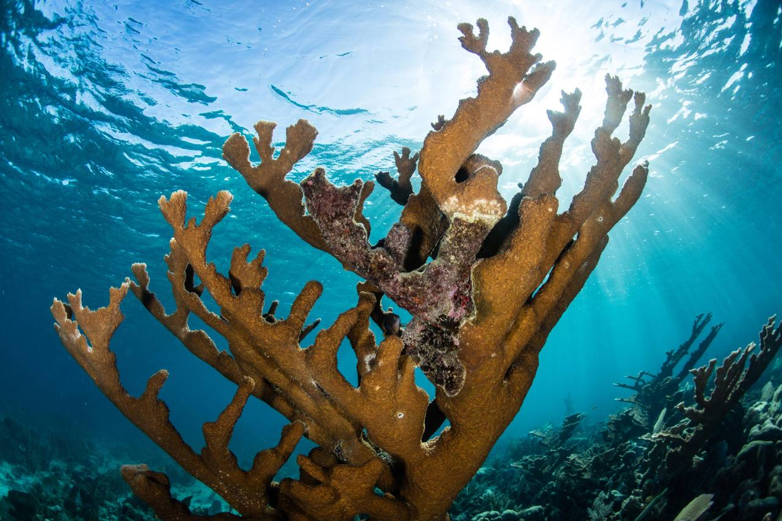
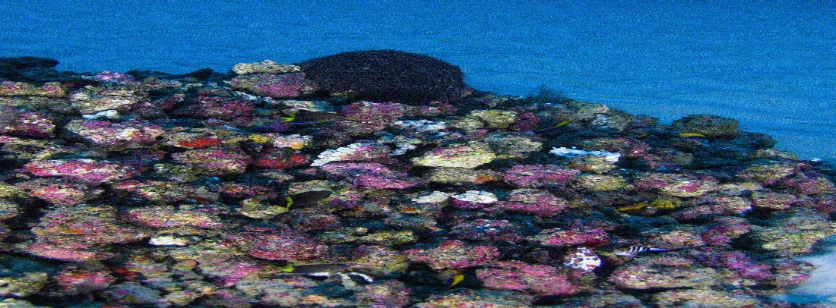
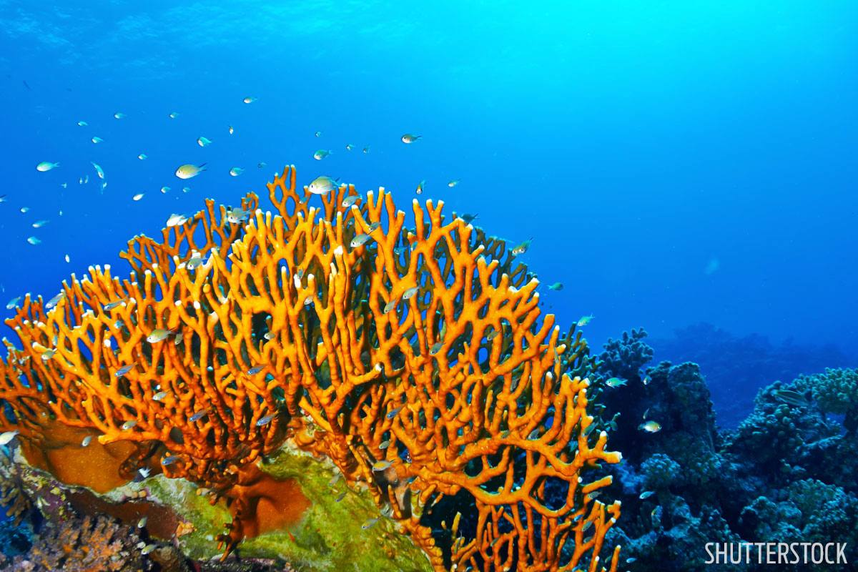
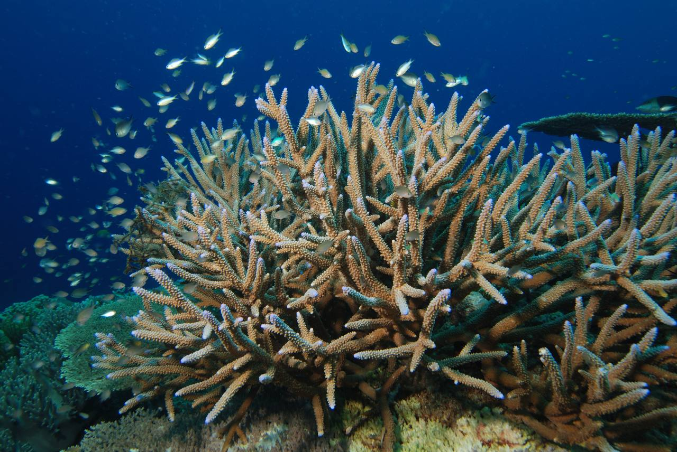
Examples of coral reefs
fig.2 Elkhorn coral reef. fig.3 Amazon reef.
fig.4 Fire reef. fig.5 Staghorn coral reef.

Slide 7
Coral reefs as tropical rainforests of the sea
Coral reefs are similar to tropical rainforests as they are also,
Located in the tropics
Highly productive
Vertically stratified

Slide 8
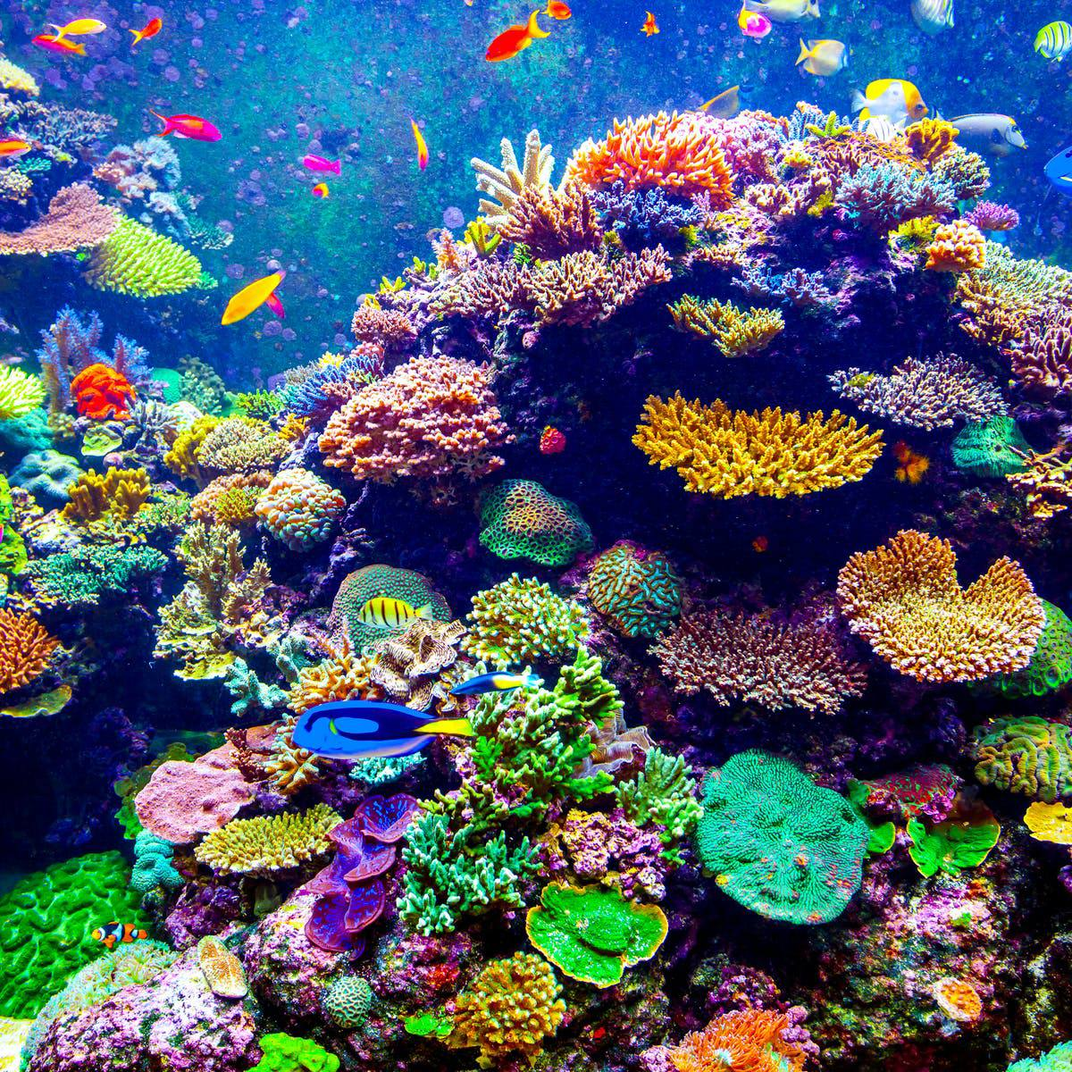
fig.6 Vertical stratification in coral reefs.

Slide 9
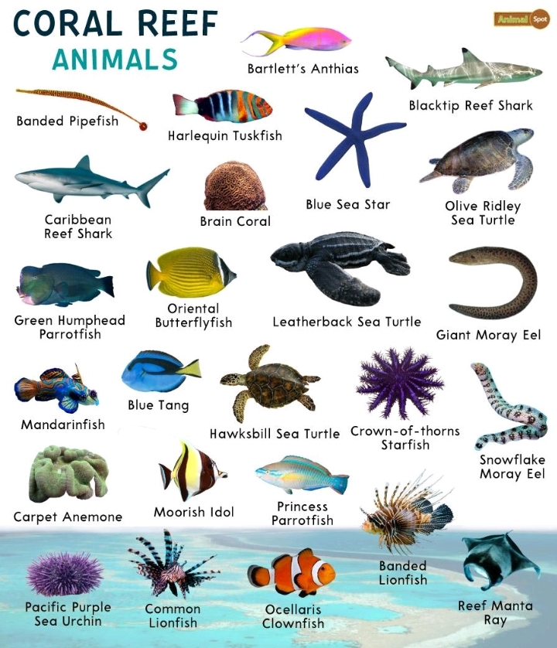
Organisms found on coral reefs
fig.7 Organisms found on coral reefs.

Slide 10
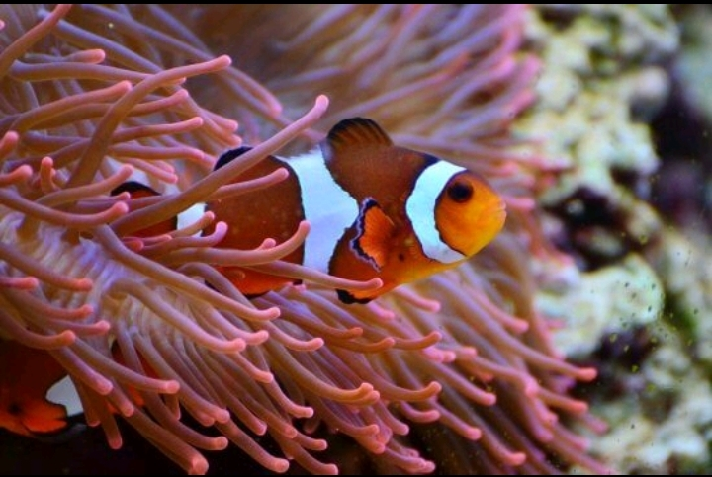
Importance of coral reefs
Defense mechanism
fig.8 Ocellaris Clownfish camouflaging in a coral reef.

Slide 11
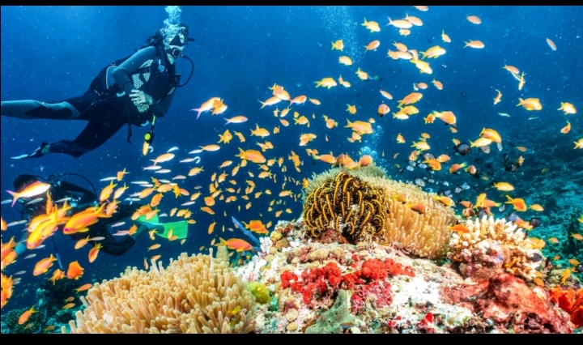
Importance of coral reefs
Tourism
fig.9 A tourist on expedition to coral reefs.
Source of food

Slide 12
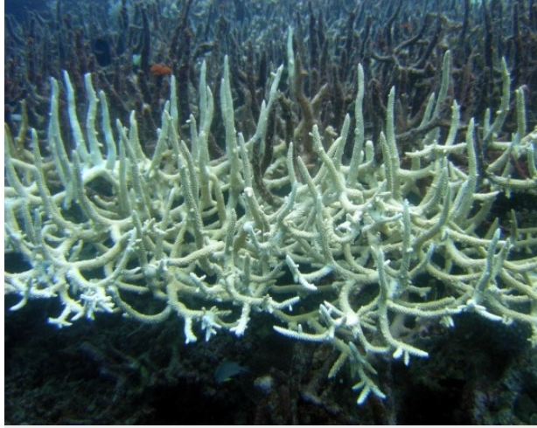
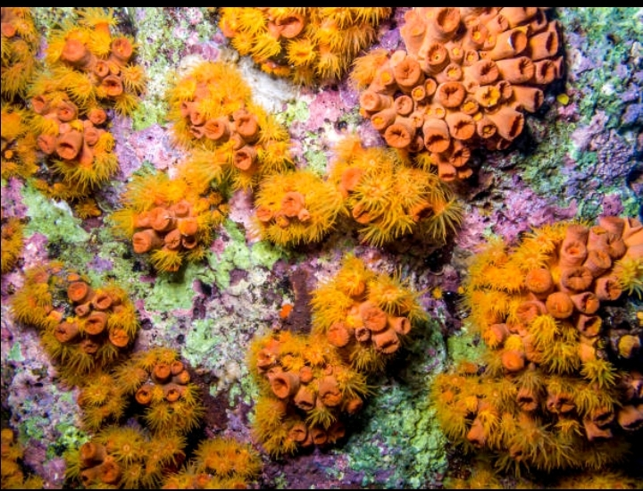
Threats faced by coral reefs
Climate change
fig.10 Bleaching of coral reefs.
Invasive species
fig.11 Invasion of orange cup corals.
Pollution

Slide 13
Future of coral reefs
According to an IPCC special report, a 1.5°C increase in ocean temperatures over the next 100 years could cause the disappearance of 70 % to 90 % of the world’s coral reefs. An increase of 2°C could induce a complete loss (IPCC, 2018).

Slide 14
Conclusion
Coral reefs are very essential to the enrichment of the biodiversity of the marine ecosystem and if they are well maintained, the biodiversity in the marine ecosystem will be well sustained.

Slide 15
References
https://oceanservice.noaa.gov/facts/coral_species.html
https://www.animalspot.net/coral-reef-animals
Summary for Policymakers of IPCC Special Report on Global Warming of 1.5°C approved by governments — IPCC. (2018, October 8). IPCC. https://www.ipcc.ch/2018/10/08/summary-for-policymakers-of-ipcc-special-report-on-global-warming-of-1-5c-approved-by-governments/
Goreau, T.J., Macfarlane, A.H. Reduced growth rate of Montastrea annularis following the 1987-1988 coral-bleaching agent. Coral Reefs 8, 211-215(1990).
Kuhlmann DHH. The sensitivity of coral reefs to environmental pollution. Ambio 17(1), 13-21, (1988).

Slide 16
References
Coral Reef Alliance, Coral 101. Types of coral reefs. https://coral.org/en/coral-reefs-101/types-of-coral-reefs-formations/
All pictures were generated by google image search of the related topics.

Slide 17
Group members
Adongo Ernest-9195919
Agbesinyale Emmanuella Sena-9196919
Aidoo Newlove-9197719
Akowuah Vanessa Obenewaa-9197919
Graham Nana Tabi-9208319
Gloria Naa Mensah-9212519
Kimberly Ofori-9214619
Kwofie Emmanuella-9211719
Manu Josephine Adufa-9212219

Slide 18
